Slide 1
Tomasulo’s Algorithm
More sophisticated technique major enhancement over score boarding
It introduces the concept of register renaming
Instruction waits for the operands in reservation status which overcome RAW hazard
Updated value of operands comes in reservation status through common data bus
Registers in instruction whose value not produced yet is replaced by values produces after some computation
Once the operands are available they are dispatched to Functional Units for computations and ther esult is written on the common data bus

Slide 2
Tomasulos Algorithm (1)
Stages of Tomasulo’s Algorithm
Issue Instruction issue to the reservation status if reservation status is free.
Execute If operands are available then instruction from reservation status goes into Functional unit.
Write Back Ther result is written back on the common data bus from where the result reaches to reservation stations which waiting for the results

Slide 3
Tomasulos Algorithm (2)
3 Parts of Tomasulos Algorithm
Instruction status (Current status of the instruction) from stages (Issue,EX,Write Back)
Reservation Station Status It has busy field which tells weather functional unit is busy or not Op field which tells operation to be performed Qj and Qk functional unit going to produce source register Vj and Vk values of source operands
Register result status Indicates which functional unit will write the register

Slide 4
Tomasulos Algorithm (3)
Instruction Queue Where instruction is loaded for execution
Floating Point Register
Buffers Store Buffer/Load Buffer (For Load and Store operation)
Address Register Used to calculate Address offset in Address Unit
Data and Address (These operation are fed into memory Unit),this helps in reading and writing data
Reservation Status For Arithmetic Operation Reservation Status receives operation from instruction Queue and operands from Floating point registers
Once everything is in reservation status that goes into an Alu
We have three FP Adders for 3 reservation units and Two FPMultipliers for 2 reservation units in this Chip

Slide 5
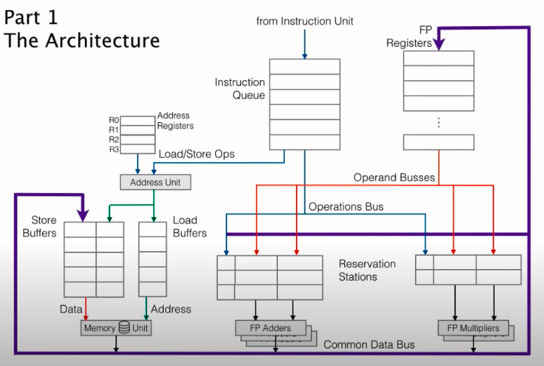

Slide 6
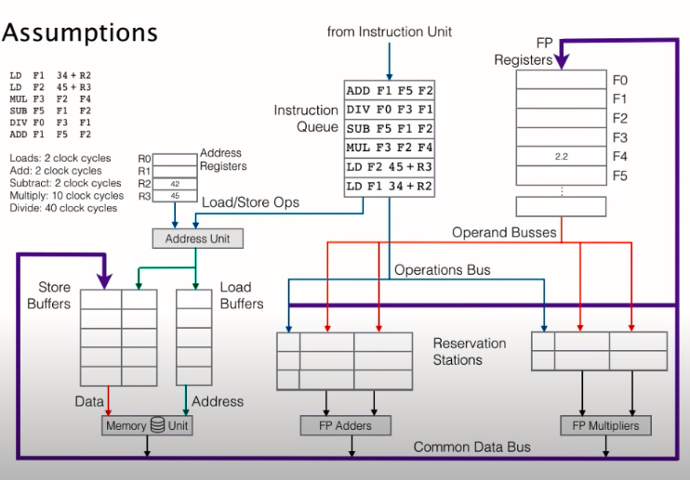
Example
We put integers in Address register (R2 and R3)
Data in floating Point register
We have set of instruction from instruction Unit

Slide 7
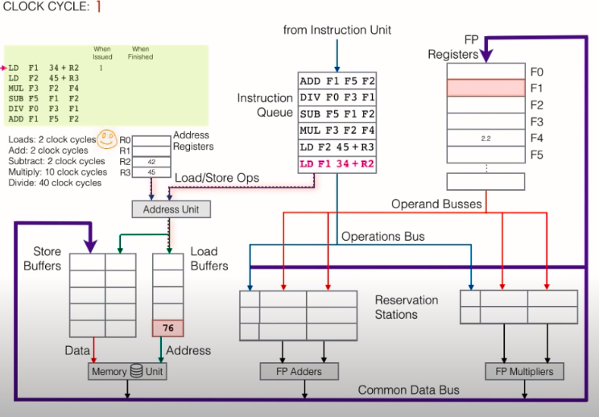
At clock cycle 1 load operands is sent to the address unit along with the address offset of 34
The address unit reads from the address register r2(42) and performs the add operation and the resultant value 76 is put into load buffer
We will code load buffer red shows it is busy and do same thing for floating point register F1 shows it is busy because it is waiting for the value from the cache

Slide 8
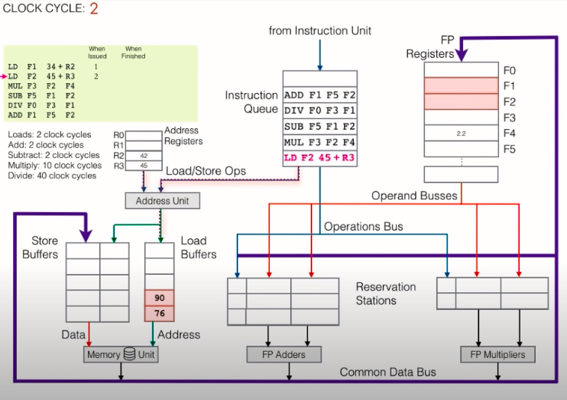
At clock cycle 2 we have second load instruction
F1 register is still busy as instruction 1 is not complete yet.
F2 register get busy status as it is the destination register for 2nd instruction

Slide 9
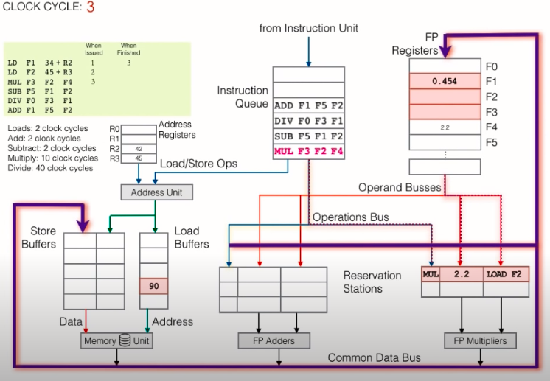
Tomasulo's Algorithim (Essence of the Algorithm)
In clock cycle 3 we have completed 1st load instruction and F1 writes its result value
As F2 is busy we don’t be able to load it in third instruction which is of Multiplication,thus we uses computation value in its place

Slide 10
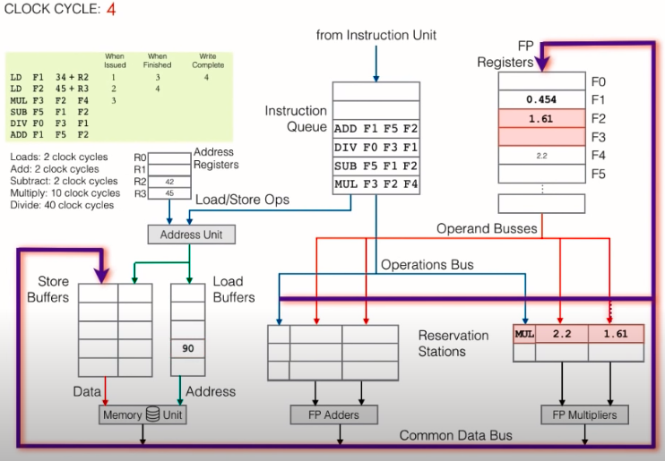
Clock Cycle 4
As in clock cycle 4 we have second load instruction completed thus we have F2 register value written in it.
We are using Common data bus thus when the result writes in register F2 it will also updated the value of F2 in Multiplier reservation station

Slide 11
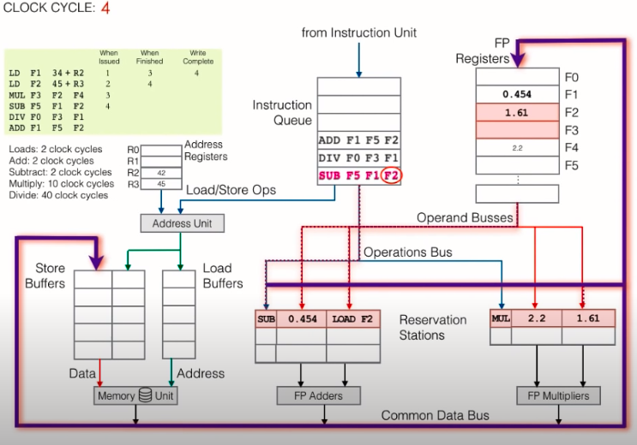
Clock Cycle 4 Continued
As in clock cycle 4 we have Sub instruction thus we uses FP adder reservation station
In reservation station for sub instruction We can write F1 register value as it is not busy but unable to write F2 value as it is still busy and used by MUL instruction.
We need to mark the destination register F5 as busy for sub instruction
F2 in FP registers is still busy as because data still not written

Slide 12
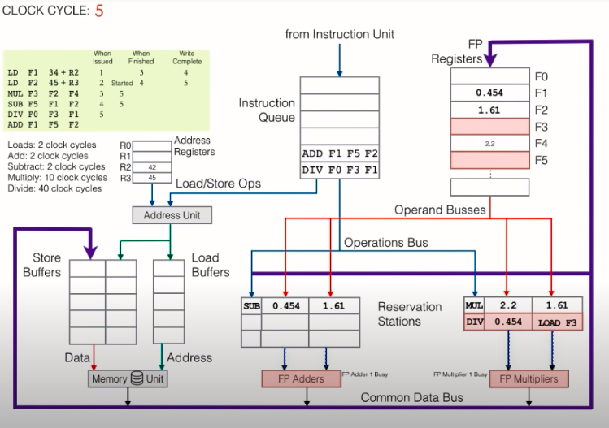
Clock Cycle 5
In clock cycle 5 data of F2 will be written in reservation station for sub instruction as F2 is free from FP Register
Subtraction operation didn’t wait for the multiplier operation to be finished, this is because chip has more than one ALU along with the reservation stations

Slide 13
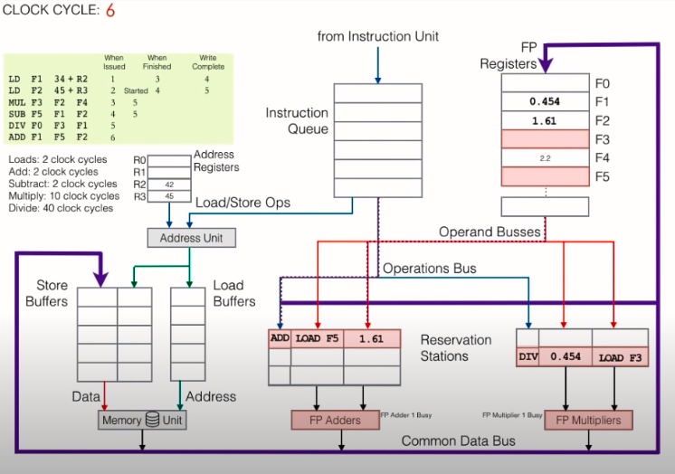
Clock Cycle 6
In Clock Cycle 6 both reservation stations get free as Sub and Mul instruction completed

Slide 14
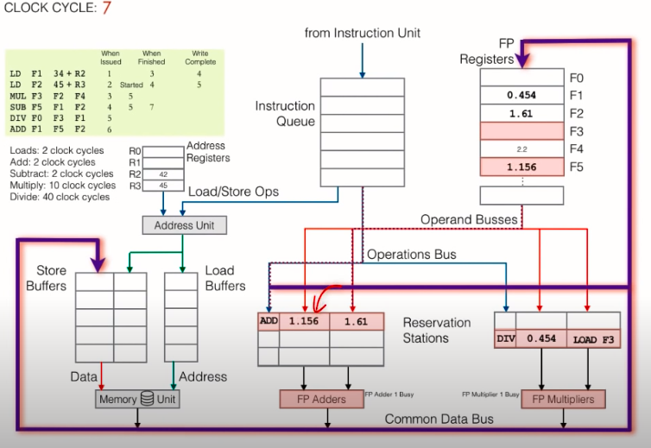
Clock Cycle 7
No more instruction is in the instruction Queue
As sub instruction completed we have F5 result which can be written through common data bus to reservation station

